Slide 1
Applied Data Science 2
Dr Ashley SpindLer
Semester A, 2022

Slide 2
TensorFlow Overview
Learn how to use TensorFlow to produce neural networks
Gain experience in both supervised and unsupervised learning methods
Understand the principle of progressive disclosure of complexity

Slide 3
Lecture 2 - Outcomes
Learn the basics of how TensorFlow functions
Get to grips with Tensors and Variables
Understand the difference between Eager and Graph execution

Slide 4
TensorFlow
TensorFlow is an end-to-end platform for machine learning. It supports the following:
https://www.tensorflow.org/guide/basics

Slide 5
TensorFlow
TensorFlow is an end-to-end platform for machine learning. It supports the following:
https://www.tensorflow.org/guide/basics
Multidimensional-array based numeric computation (similar to NumPy.)
GPU and distributed processing
Automatic differentiation
Model construction, training, and export
And more

Slide 6
Tensors
Tensors are the core component of the TensorFlow platform—it’s where the name comes from.
Tensors are multi-dimensional arrays that “flow” through the analysis pipeline
In many ways Tensors are similar to Numpy Arrays

Slide 7
Tensors
Tensors are the core component of the TensorFlow platform—it’s where the name comes from.
Tensors are multi-dimensional arrays that “flow” through the analysis pipeline
In many ways Tensors are similar to Numpy Arrays
The two most important properties of a Tensor are it’s Tensor.shape and Tensor.dtype
Tensors are immutable—the contents of a tensor cannot be updated, only new Tensors can be created.
TensorFlow is designed with GPU acceleration in mind—More on this later!

Slide 8
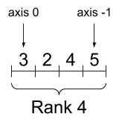
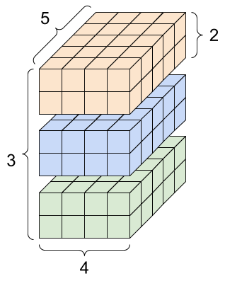
About Tensor Shapes
Tensor shapes are defined by the following characteristics:
Shape: The number of elements along each axis
Rank: The number of axes
Axis/Dimension: referring to a particular dimension of the Tensor
Size: The total number of elements
Source: https://www.tensorflow.org/guide/tensor

Slide 9
About Tensor Shapes
Tensor shapes are defined by the following characteristics:
Shape: Tuple, (3,2,4,5)
Rank: Int, 4
Axis/Dimension: referring to a particular dimension of the Tensor
Size: Int, 3*2*4*5=120
Source: https://www.tensorflow.org/guide/tensor

Slide 10
Tensors can be reshaped
When we change the shape of a tensor, we use the function:
tf.reshape(tensor, shape)
e.g:
tf.reshape(X, (6, 20))
The size of a tensor cannot be changed by reshaping. e.g.:
﻿tf.reshape(X, (10,10))
﻿InvalidArgumentError: Input to reshape is a tensor with 120 values, but the requested shape has 100 [Op:Reshape]

Slide 11
Tensors can be reshaped
When we change the shape of a tensor, we use the function:
tf.reshape(tensor, shape)
e.g:
tf.reshape(X, (6, 20))
The size of a tensor cannot be changed by reshaping. e.g.:
﻿tf.reshape(X, (10, 10))
﻿InvalidArgumentError: Input to reshape is a tensor with 120 values, but the requested shape has 100 [Op:Reshape]
It is also important to consider the ordering of the axes. When we reshape a tensor, we should only combine adjacent axes, e.g.:
﻿ X=<tf.Tensor, shape=(3, 2, 4, 5)>
tf.reshape(X, (3*2, 4*5))
tf.reshape(X, (3, 2*4, 5))
Reshaping should not be used to reorder axes, or combine non-adjacent axes, e.g.:
tf.reshape(X, (3*5, 2*4))
tf.reshape(X, (4, 2*5, 3))
tf.reshape(X, (4*5, 3*2))

Slide 12
Numpy Arrays and Tensors
You can convert a Tensor to a number array like this:
np.array(tensor)
tensor.numpy()
Most TensorFlow “Ops” will automatically convert non-tensors to tensors, but you can also call:
tf.convert_to_tensor()

Slide 13
Variables
Variables are data objects similar to Tensors, but crucially their contents are tracked.
Variables are used to store model parameters, and can be modified by certain Ops.

Slide 14
Variables
Variables are data objects similar to Tensors, but crucially their contents are tracked.
Variables are used to store model parameters, and can be modified by certain Ops.
A variable looks and acts like a tensor, it has a shape, type and can be converted to NumPy
Variables cannot be reshaped
A variable can be reassigned, as long as the new value does not change the size

Slide 15
Variables as Weights and Biases
class Dense(tf.Module):
“““A Simple Fully-connected Layer””” def __init__(self, in_features, out_features, name=None): super().__init__(name=name)
# Weights and Biases of the Neurons self.w = tf.Variable( tf.random.normal([in_features, out_features]), name='w') self.b = tf.Variable(tf.zeros([out_features]), name='b’)
def __call__(self, x):
# Weighted sum of the inputs (think: “little math box”) y = tf.matmul(x, self.w) + self.b return tf.nn.relu(y)

Slide 16
Aside: Backpropagation and Differentiation

Slide 17
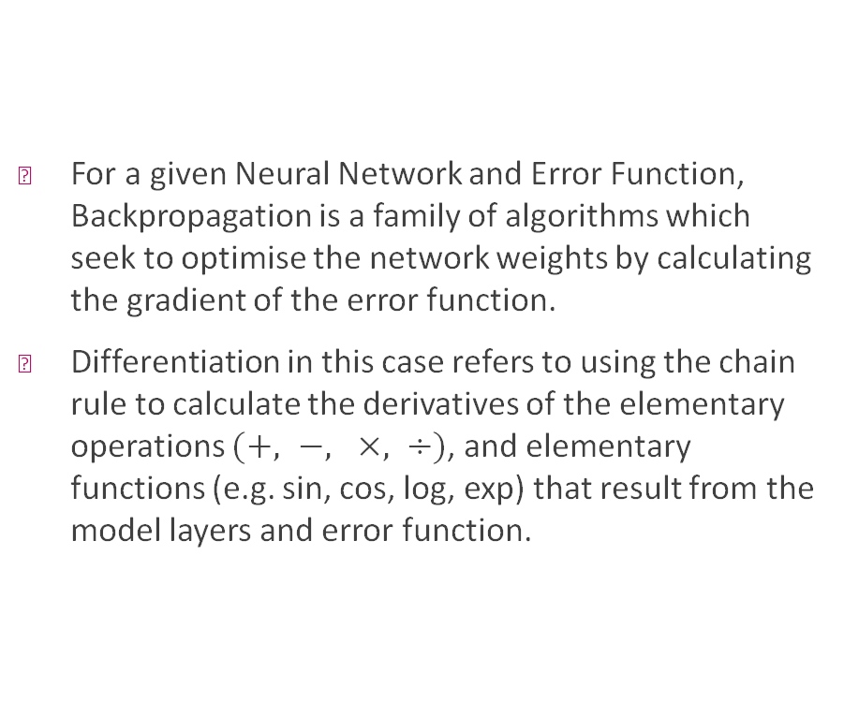
Aside: Backpropagation and Differentiation
For a given Neural Network and Error Function, Backpropagation is a family of algorithms which seek to optimise the network weights by calculating the gradient of the error function.
Differentiation in this case refers to using the chain rule to calculate the derivatives of the elementary operations $(+, −, ×, ÷)$, and elementary functions (e.g. sin, cos, log, exp) that result from the model layers and error function.

Slide 18
AutoDiff and Gradients
TensorFlow performs differentiation of operations automatically.
In the Forward Pass, it makes a record of all the operations that happen.
Then, in the Backward Pass, it traverses the list and calculates the gradients.

Slide 19
Gradient Tapes
Automatic Differentiation is handled by the tf.GradientTape API.
Tensorflow makes a record of the operations with respect to some inputs, such as Variables, along the “tape”.
The tape is then used to compute the gradients in reverse order.

Slide 20
Graphs, Models and Training Loops
Up until now, you have seen TensorFlow operating eagerly, where the operations are executed step-by-step by Python.
Eager execution is useful for testing and debugging, but TF’s real strength is in Graph computation.
Graph computation is analogous to the Lazy execution in PySpark.

Slide 21
Graphs
Up until now, you have seen TensorFlow operating eagerly, where the operations are executed step-by-step by Python.
Eager execution is useful for testing and debugging, but TF’s real strength is in Graph computation.
Graph computation is analogous to the Lazy execution in PySpark.
Graphs are data structures that contain a predefined set of TF Ops and Tensors—they represent the flow of data between operations.
All of the information required to run the operations in the graph are stored in the data structure—this enables computation outside of Python.
Graphs are faster than Eager execution, don’t require a python instance to run, and run in parallel.

Slide 22

How we use TensorFlow (Short Version)
Import
Import tensorflow modules and functions
Load in and process
Load in and process our dataset
Define
Define a model to train using our data
Compile
Compile the model with a loss function and training algorithm
Fit
Fit the model to the data
Test
Test the model against new data
Modify
Modify the model to improve results
Save
Save the best version of the model

Slide 23
Review
TensorFlow is an end-to-end platform for building ML models—it is based on the flow of Tensor Objects
Tensors and Variables make up the core components of TF. They have shapes, types, and operations on them can be tracked
TensorFlow uses Backpropagation to train models, and does so efficiently by building Graphs of operations

Slide 24
Questions???

